Slide 1
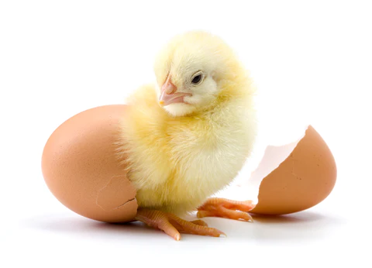
ML for Analyzing
Egg Hatching
6SP PROJECT PROPOSAL: GROUP 06

Slide 2




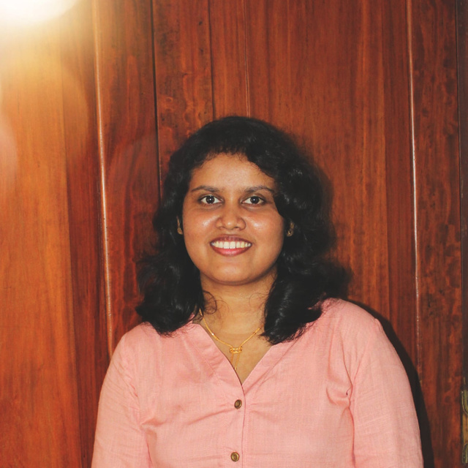
Our Team
Project owner
Coodinator
E/18/030
Sathsarani
Aththanayaka
E/18/282
Nethmi
Ranasinghe
E/18/283
Jayathri
Ranasinghe
Dr. Nipuna Perera
Faculty of Agriculture
University of Peradeniya
Mrs. Nadeesha Adikari

Slide 3

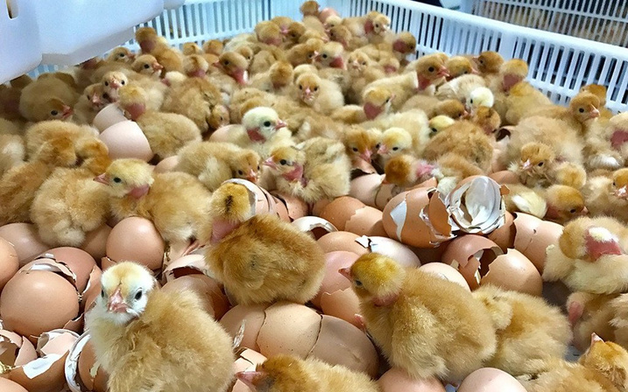
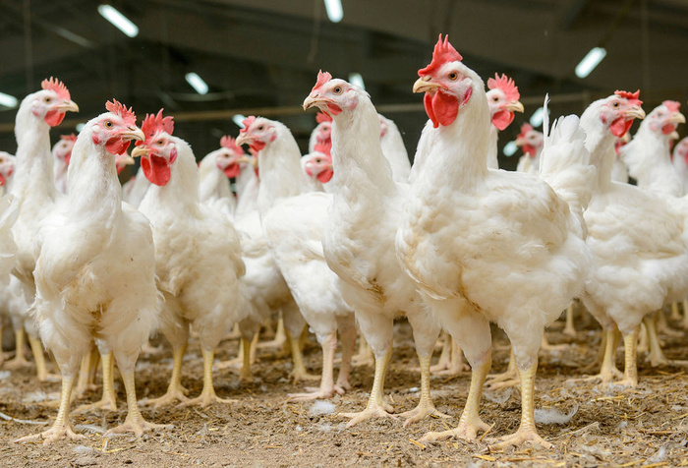

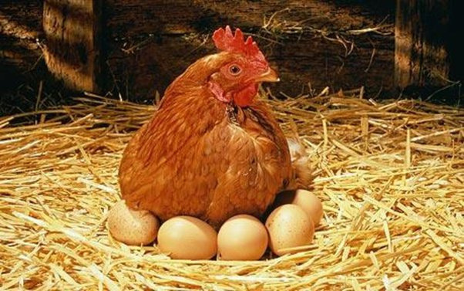
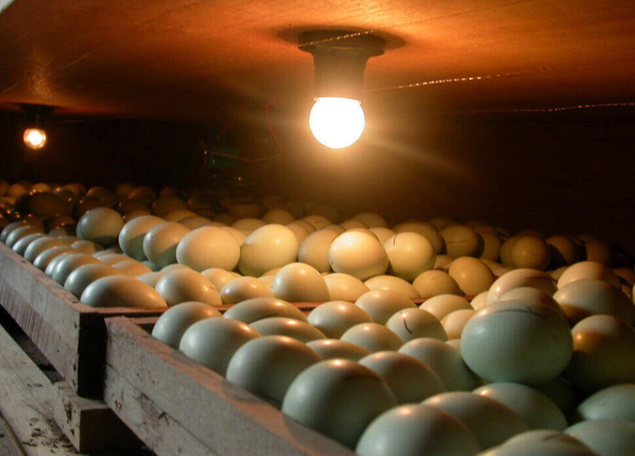
The life cycle of an Egg
A batch of breeder chicks
Hatching (up to 21 days)
Eggs
Incubation
(on 26th week)
(next 18 days)

Slide 4
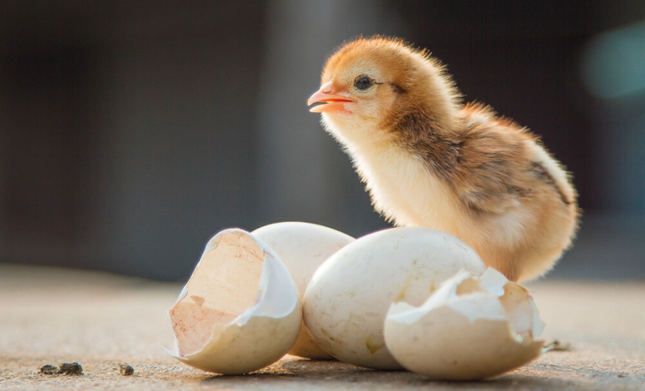
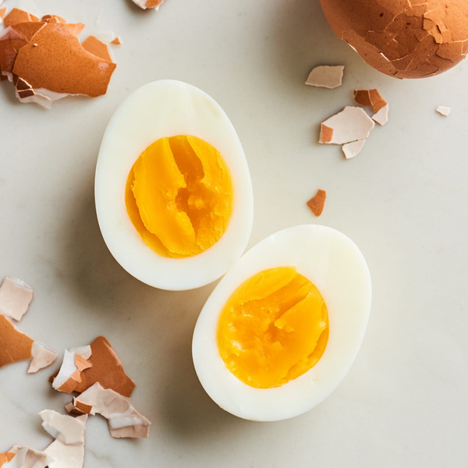

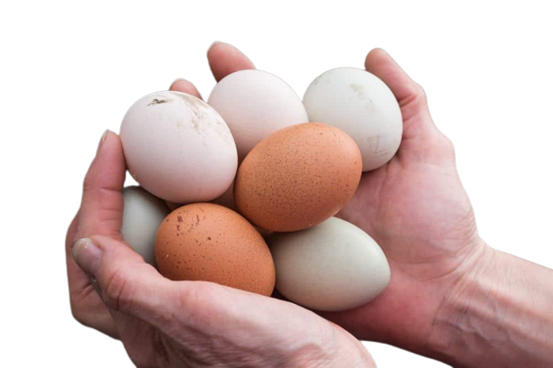
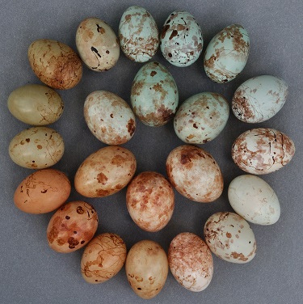
Problem
Domain
Fertile eggs
Edible eggs
Can plan on,
Resource allocation
Quality control measures
Operational strategies
Rejected eggs

Slide 5
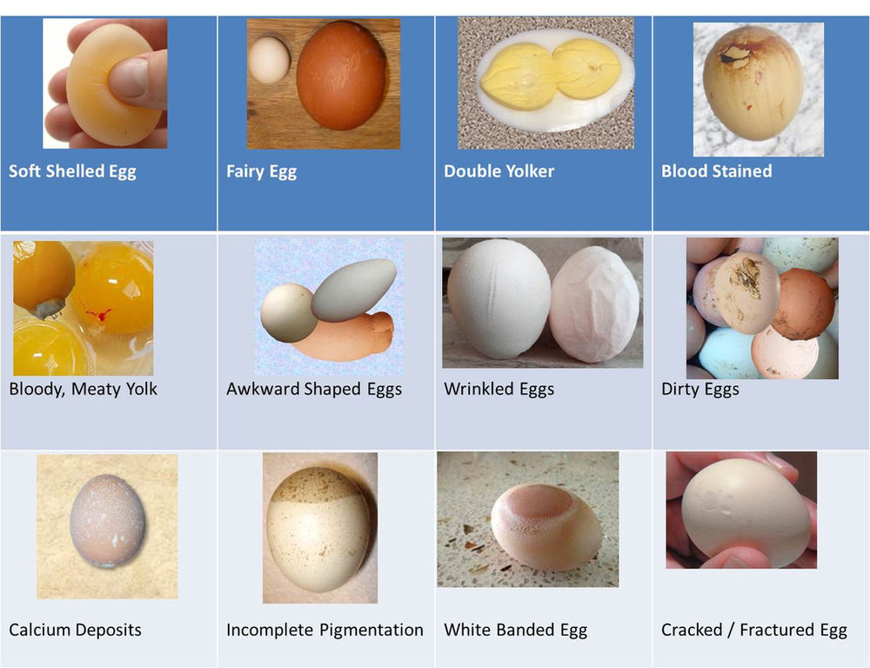
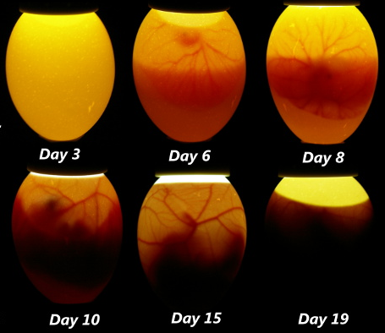
Before sending to the incubator, eggs are categorized as good and bad eggs depending on their external appearance.
Before sending to the hatchery, candling is used to identify whether there is a growing embryo inside the egg.
Traditional methods are inaccurate

Slide 6







Solution
Light Intensity
Temperature
Number of Hens and weight
ML Model
Hatchability
Feed
Humidity

Slide 7
Software Requirement
A responsive web application
Enter inputs regarding to a particular day
Display the predicted number of chicks
Display Graphs to show the trends or pattern identified
Ex: Chicks prediction comparing to other features

Slide 8








Solution Architecture
Backend Server
Database
Trained ML Model
Frontend

Slide 9

Impact
Improve fertility rates
Cost savings
Customization
Reduce wastage and inefficiency
Prevent overproduction and underproduction of chicks
Minimize defective eggs by implementing quality control measures

Slide 10



Extendability
Documentation
Code organization
Version control
Unit tests and integration testing
Feature addition

Slide 11

Challenges
Limited data
Hard to obtain datasets from farms
Privacy and confidentiality concerns
All required features are not available
Lack of standardized data formats

Slide 12








Work Plan
Software Development
Data Access
Data Analysis
Model Development
Model Deployment & Intregation
Human Review
Data Labeling & Preparation
Model Testing

Slide 13

Thank You

Slide 14

QnA

